Slide 1
Programming Fundamentals
Course Code: CS-111
Course Instructor: Isra Naz

Slide 2
 Programming Fundamentals
Goals for today:
Typical C++ development environment
Writing a simple C++ program

Slide 3

 C++ systems generally consist of three parts:
a program development environment (IDE)
the language and
the C++ Standard Library.
C++ programs typically go through six phases:
edit,
preprocess,
compile,
link,
load and
execute

Slide 4
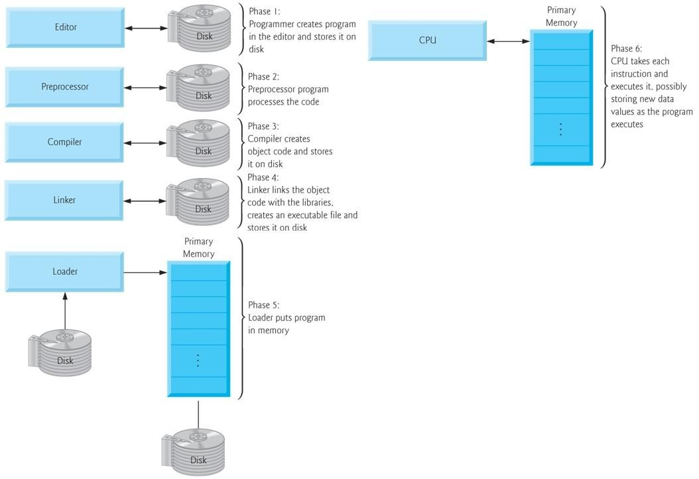

Slide 5
 Phase 1- Editor
Type a C++ program (source code) using the editor.
Save the program.
C++ source code filenames often end with the .cpp,
.cxx, .cc or .C extensions (note that C is in uppercase) which indicate that a file contains C++ source code.
Examples of Editors
Linux – vi, emacs
Microsoft Windows – Microsoft Visual C++
Simple editors like Notepad

Slide 6
 Phase 2 – preprocessor
The C++ preprocessor obeys commands called preprocessor directives, which indicate that certain manipulations are to be performed on the program before compilation.
These manipulations usually include other text files to be compiled, and perform various text replacements.
In Phase 3 – compiler
It translates the C++ program into machine- language code -also referred to as object code.

Slide 7
 Phase 4 – linking
The object code produced by the C++ compiler typically contains ―holes‖ due to these missing parts.
A linker links the object code with the code for the
missing functions to produce an executable program.
Phase 5 – loading
Before a program can be executed, it must first be placed in memory.
The loader takes the executable image from disk and transfers it to memory.
Additional components from shared libraries that
support the program are also loaded.

Slide 8
 Phase 6 - Execution
Finally, the computer, under the control of its CPU, executes the program one instruction at a time.
Some modern computer architectures can execute several instructions in parallel.
Problems that may occur at execution
If problem occurs, you have to return the editor phase, make necessary corrections and proceed with rest of the phases.

Slide 9
C++ Program Structure
A C++ program consists of three parts:
Preprocessor Directives
Main() function
C++ statements

Slide 10
Preprocessor directive that tells the processor to include I/O library in C++
// a first program in c++.
#include <iostream>
using namespace std;
// function main begins program execution
int main()
{
cout << "welcome to c++!\n";
return 0; // indicate that program ended successfully
} // end function main
All the elements of the standard C++ library are declared within what is called a namespace, the
namespace with the name std.
Main function
C++ Statements
Welcome to C++!

Slide 11
C++ Program
Preprocessing :
In a C++ program, statements that begin with the symbol # are called preprocessor directives.
It defines the behavior that are to be carried out on the source code before compiled
It process the program before compilation
Using directive
using namespace std;
Various program components such as cout are within std namespace. If we do not add this statement then std will have to be added with many statements
std::cout << Every age has a language of its own;
Namespace is a collection of classes, functions and objects Using directive has to be used in Microsoft compilers for C++

Slide 12
main()
The program consists of a single function main()
main() is called the entry point of any C++ program as the control always go to main() on startup.
Without the main() in your program, an error will be generated.

Slide 13
Statements
The function body contains the executable statements.
Every executable statement ends with a semicolon.
cout refers to the standard output stream. A stream refers to flow of data. In this case the screen display.
The statement return 0; tells main() to return integer 0 to whoever called it, in this case operating system or compiler.
In older versions of C++ we used void with main() instead of return 0 statement, i.e. the program did not use any return statement as return type was void

Slide 14
Program Execution
Steps taken by the CPU to run a program (instructions are in machine language):
Fetch an instruction
Decode (interpret) the instruction
Retrieve data, if needed
Execute (perform) actual processing
Store the results, if needed

Slide 15
Program Errors
Syntax Errors:
Errors in grammar of the language
Runtime error:
When there are no syntax errors, but the program can’t complete execution
Divide by zero
Invalid input data
Logical errors:
The program completes execution, but delivers incorrect results
Incorrect usage of parentheses

Slide 16

Input and Output
Comments
Escape Sequences
Variables and constants
Data types
Arithmetic operators

Slide 17

C++ uses cout for output and cin for input
cout
It stands for console output.
It is used to display content to computer screen/
console.
It is a predefined object.
It is part of iostream header file.
Examples
cout << “Hello world”;
cout << “Hello” << “world”;
cout << a+b;
where a and b are integer variables

Slide 18
cin
It stands for console input.
It is a predefined object.
It is part of iostream header file.
When cin input statement is executed the computer waits to receive an input from keyboard.
When a value is typed by user and enter key is pressed, the value is assigned to the variable and control shifts to next executable statement
Example
cin >> var1;

Slide 19
# include<iostream>
int main ( )
{
int var1;
cout<< “enter a number”;
cin >> var1;
cout<< “you have entered ” << var1;
return 0;
}

Slide 20
# include<iostream> int main ( )
{
int num1, num2;
cout<< “lets add two numbers, enter first number”;
cin >> num1;
cout<< “enter second number; cin >> num2;
cout << num1 + num2 ; return 0;
}

Slide 21

 You insert comments in programs
to document your programs and
to help other people read and understand your programs.
 Comments are ignored by the C++ compiler and do not cause any machine-language object code to be generated.

Slide 22
// this program is about comments
# include<iostream> // allows program to output data to screen
//function main begins program execution int main ()
{
cout<< “This is about comments”; // display message return 0; //indicates that program ended successfully
} // end of main function

Slide 23
// indicates that the remainder of each line is a comment.
Single-line comment
A comment beginning with // is called a single-line comment because it terminates at the end of the current line.
You may use C‟s style multiple-line comments which begin with /* and end with */.

Slide 24
/* this program is about multiple-line comments its another type of comment
this program has been written by programmer X and it prints some text on screen
*/
# include<iostream> int main ()
{
cout<< “This is about comments”; return 0;
}

Slide 25

They are some special non-printing characters.
They are not printed but are used to control printing/display on the output device.
An escape sequence is a combination of back slash „\‟ and a character code.
They are used inside strings or independently, for example
Use within string cout<<“hello \n world”; OR
Use independently cout<< “hello”; cout<<“\n”; cout<< “world”;

Slide 26
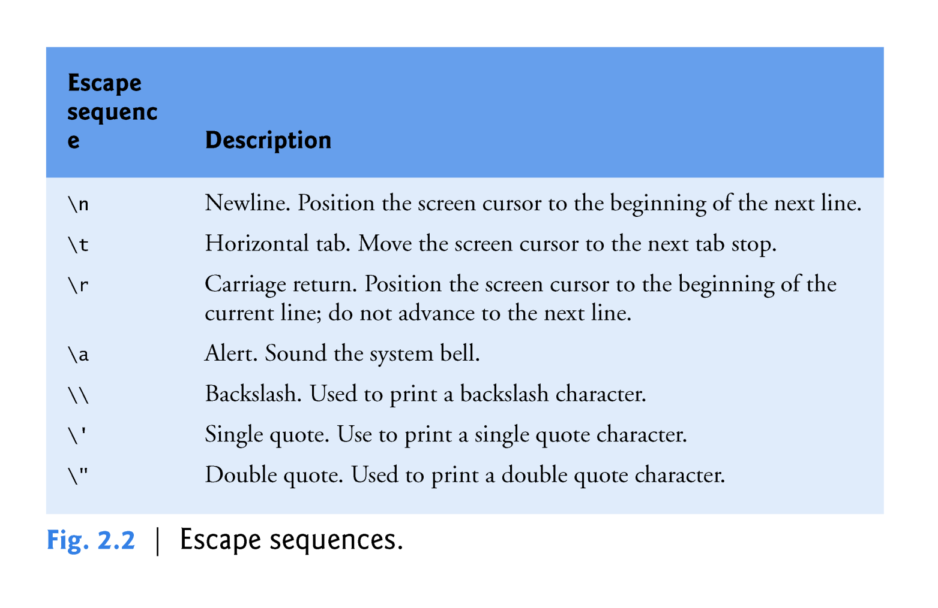

Slide 27
\n
cout <<“welcome \n to \n C++”;
\t
cout <<“welcome \t to \t C++”;
\r
cout<<“welcome \r to \r C++”;
\a
cout<<“program end \a”;

Slide 28
\\
cout<<“Select D: \\ drive”;
\‟
cout<<“welcome to \‟ programming\‟ ”;
\”
cout<<“welcome to \” programming \” ”;

Slide 29

# include<iostream>
int main ( )
{
int num1, num2;
cout<< “lets add two numbers, enter first number \n”;
cin >> num1;
cout<< “enter second number\n”; cin >> num2;
cout<< “sum of \t” << num1<<“and \t”<<num2<<“is”; cout << num1 + num2 ;
return 0;
}

Slide 30

The output of two or more cout statements appears on the same line on output screen.
No linefeed is inserted automatically.
To print on a new line „\n‟ is be used.
Another way is to use endl manipulator.
cout<< “Hello everyone”<< endl;

Slide 31

A variable is a location in computer‟s memory where a value is stored for use by a program.
Variable declaration
All variables must be declared with a name and a data type before they can be used.
If more than one variable is declared in a declaration statement, the names are separated by commas (,) this is referred to as a comma- separated list.
 int x, y, z;

Slide 32
Variable Names
A variable name is any valid identifier that is not a keyword.
An identifier is a series of characters consisting of letters, digits and underscores ( _ ) that does not begin with a digit.
C++ is case sensitive—uppercase and lowercase letters are different, so a1 and A1 are different identifiers.

Slide 33
You can define variables throughout the program in C++.
Many languages, including C require all variables to be defined before the first executable statement.
Examples of variable names
value1
First_number
Ahmed

Slide 34
Constants
The name constants are given to such variables or values in C/C++ programming language which cannot be modified once they are defined.
They are fixed values in a program.
There can be any types of constants like integer, float, octal, hexadecimal, character constants, etc.
The keyword ‘const’ is used.
For example: const int var = 5;

Slide 35

int
char
float
double
bool

Slide 36

A variable of type int holds integer values, i.e. whole numbers such as 7, -11, 0, 9265
Depending on computer system, int occupies different sizes in memory.
In 32-bit system (e.g. Windows 98), int occupies 4 bytes in memory while it takes 2 bytes in MS-DOS .
It can store values from -2,147,483,648 to 2,147,483,647

Slide 37

A variable of type char holds only a single lower case letter, a single uppercase letter, a single digit or a single special character (e.g.,
$ or *)
char takes only 1 byte in memory.
It can store values from -128 to 127.

Slide 38

A variable of type float holds floating type data or real numbers, e.g., -11.4, 3.1416.
Float occupies 4 bytes in memory.
It can store values in range 3.4 x 10-38 to 3.4x1038

Slide 39

A variable of type double holds large real numbers, e.g., 11.234, 1.6x10⁻⁵⁰
Storage capacity of double is twice the capacity of float data type

Slide 40

bool stands for boolean.
A variable of type bool can hold true or false.
True is equivalent to 1 and false is equivalent to 0.

Slide 41
Examples of variable declaration:-
int a, xy;
float b;
char val;
double product;

Slide 42
When a variable is declared, a memory location is assigned to it.
The value in that memory location is also assigned to that variable. We may call it garbage value.
A known value must be assigned to the variable to avoid mistakes in calculations/ processing due to garbage value.
Value assignment at the time of declaration is called initialization.
If not initialized, a variable can be assigned a value later in the program too.
int a=110, b=40, c;

